Slide 1
ElectRomagnetic theory Maxwell equations & Electromagnetic waves

Slide 2
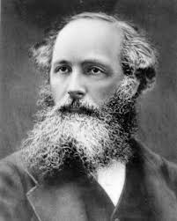
Maxwell’s equations
Maxwell's equations are a set of partial differential equations that, together with the Lorentz force law, form the foundation of classical electrodynamics, classical optics, and electric circuits. These fields in turn underlie modern electrical and communications technologies. Maxwell's equations describe how electric and magnetic fields are generated and altered by each other and by charges and currents. They are named after the physicist and mathematician James Clerk Maxwell, who published an early form of those equations between 1861 and 1862.

Slide 3
Maxwell equations
Differential form
Integral form

Slide 4
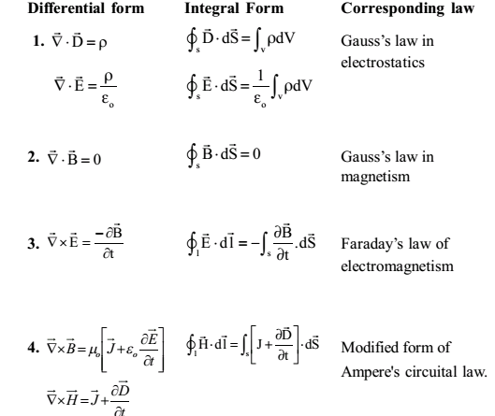

Slide 5
Maxwell First Equation
Gauss’s Law for Electricity
Statement- It states that the total electric flux through the closed surface is equal to (1/ε₀) times the total charge enclosed by the surface.

Slide 6

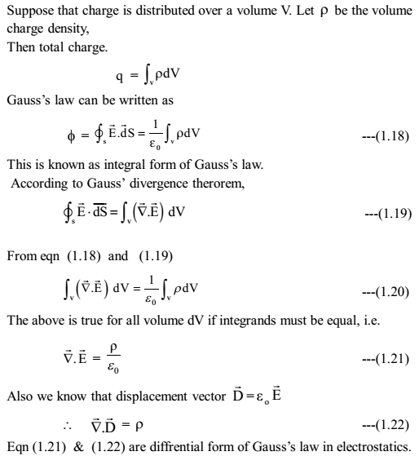
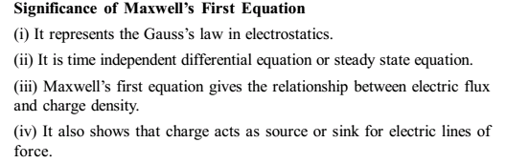
Maxwell 1st Equation:

Slide 7
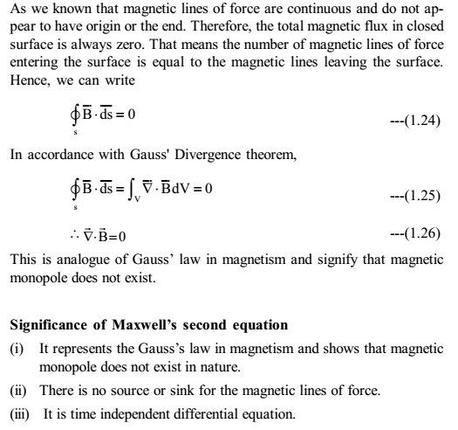
Maxwell 2nd Equation:

Slide 8
Maxwell’s 3rd equation Faraday’s Law of Electromagnetic Induction
Statement- This law states that an electromotive force (EMF) is induced in a circuit, if there is a change in the magnetic flux linked through the circuit and if the circuit is closed, an induced current begins to flow.
The induced emf is equal to the rate at which the magnetic flux changes through the circuit.

Slide 9


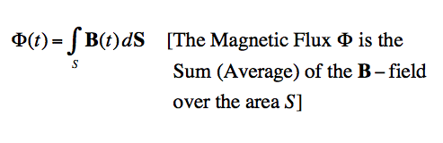
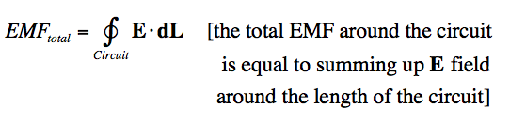

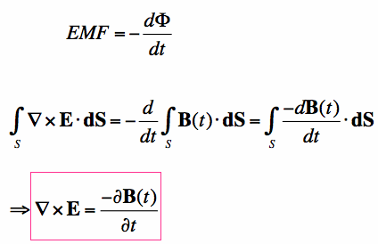
Maxwell 3rd Equation:
According to Faraday’s law,
is the Magnetic Flux within a circuit, and EMF is the electro-motive force
Significance of Maxwell’s third equation (i) It summarizes the Faraday’s law of electromagnetic induction. (ii) This equation relates the space variation of electric field with time variation of magnetic field (iii) It is time dependent differential equation. (iv) It proves that the electric field can be generated by change in magnetic field
Also,

Slide 10
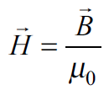
Ampere’s circuital Law
Statement- The line integral of magnetic field B around any closed loop is equal to µ₀ times the net current I flowing through the area enclosed by the loop.
where µ₀ is the permeability of free space.

Slide 11

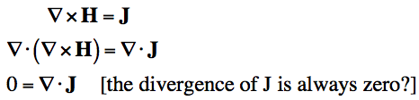


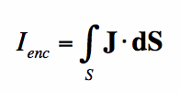
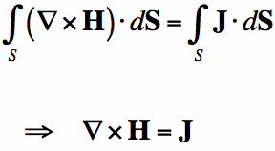


Maxwell 4th Equation:
According to Ampere’s Law
Maxwell realized that the definition of the total current density is incomplete and suggested to add another term

Slide 12
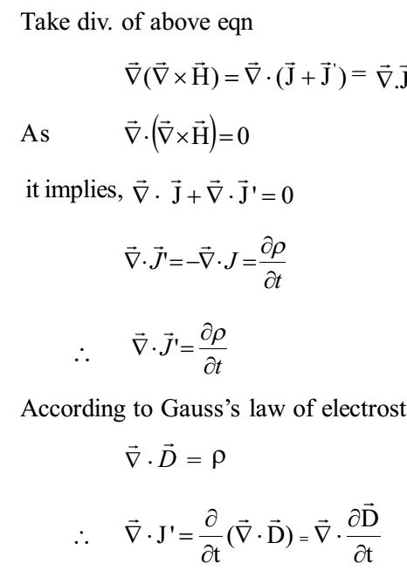
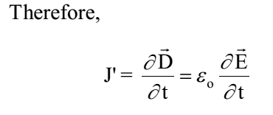
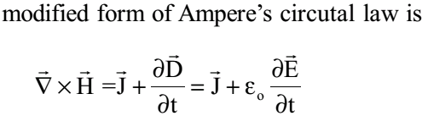
Significance of Maxwell’s fourth equation (i) It summarizes the modified form of Ampere’s circuital law. (ii) It is time dependent differential equation. (iii) Maxwell’s fourth equation relates the space variation of magnetic field with time variation of electric field (iv) It also proves that magnetic field can be generated by changing electric field

Slide 13
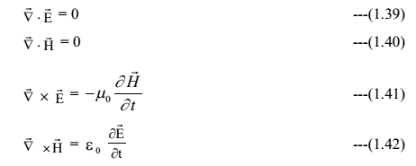

PROPAGATION OF ELECTROMAGNETIC WAVE IN FREE SPACE
The Maxwell’s equation for free space (ρ=0 and J=0) can be written as

Slide 14
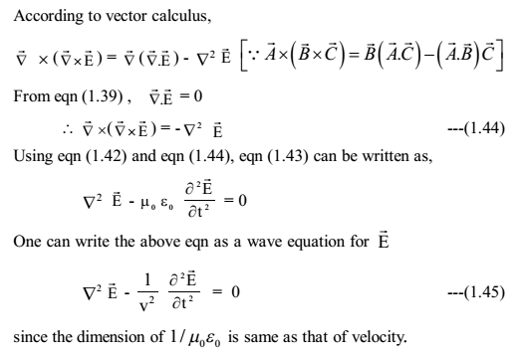
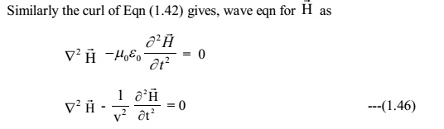

Slide 15
